Slide 1
BANK LOAN ANALYSIS
SQL

Slide 2
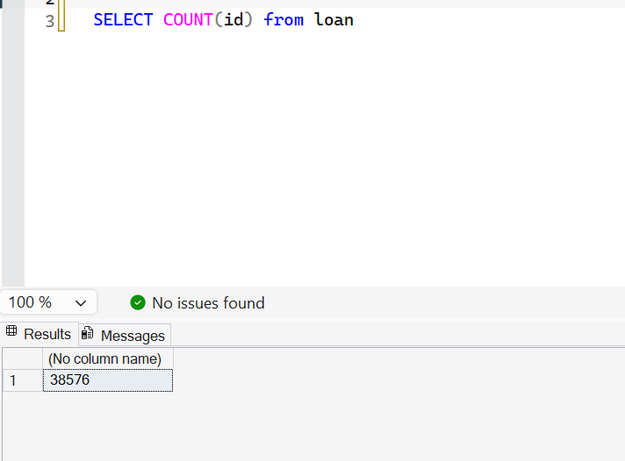
TOTAL LOAN APPLICATIONS

Slide 3
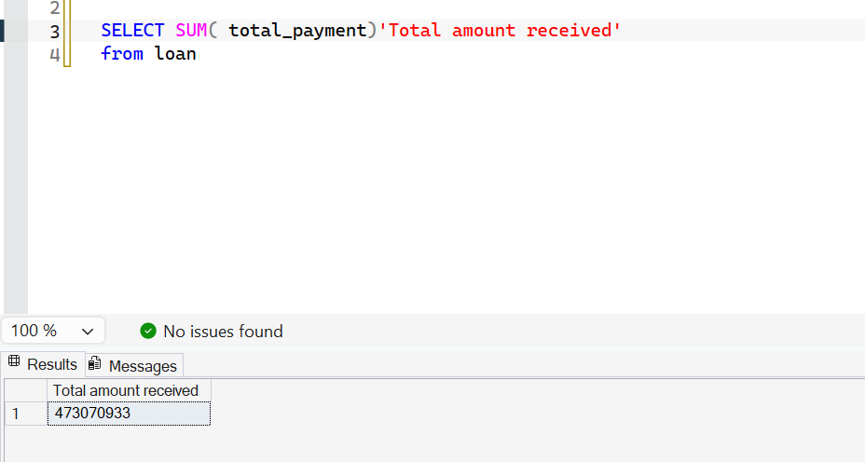
AMOUNT RECEIVED(PAYMENTS)

Slide 4
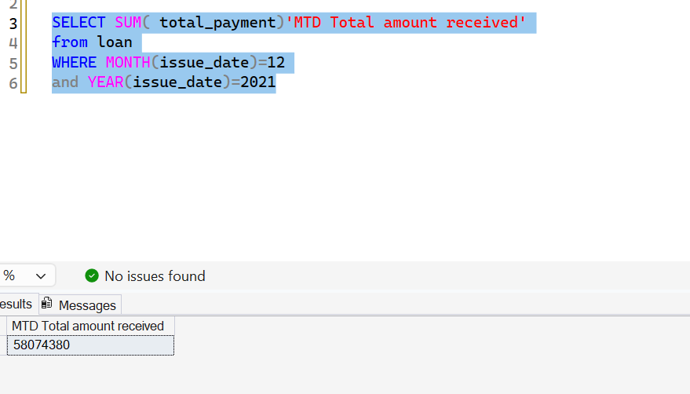
TOTAL PAYMENTS FOR CURRENT MONTH

Slide 5
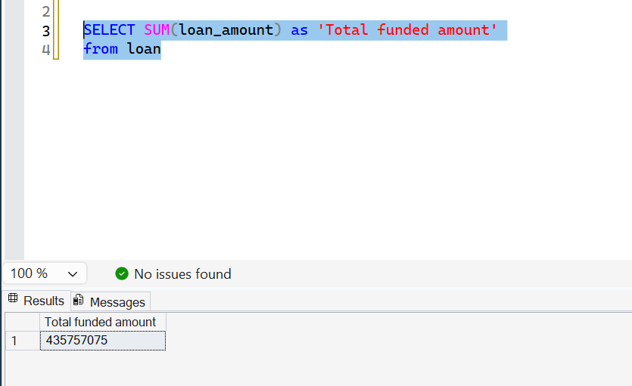
TOTAL FUNDED LOAN AMOUNT

Slide 6
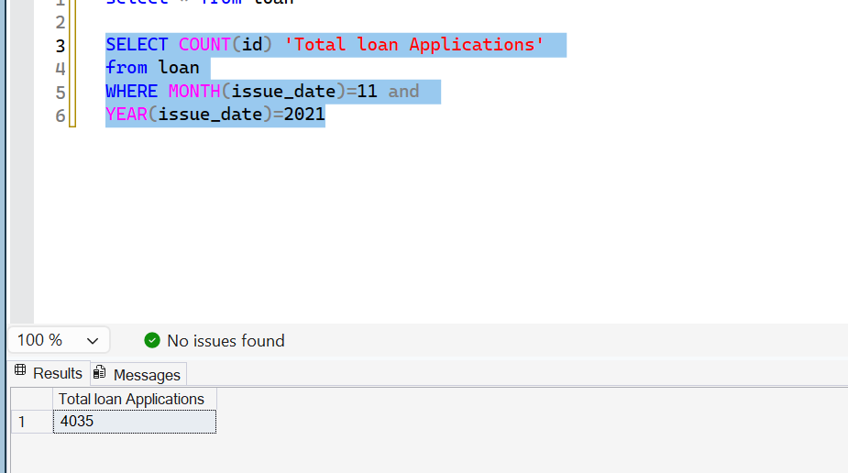
PREVIOUS MONTH LOAN APPS

Slide 7
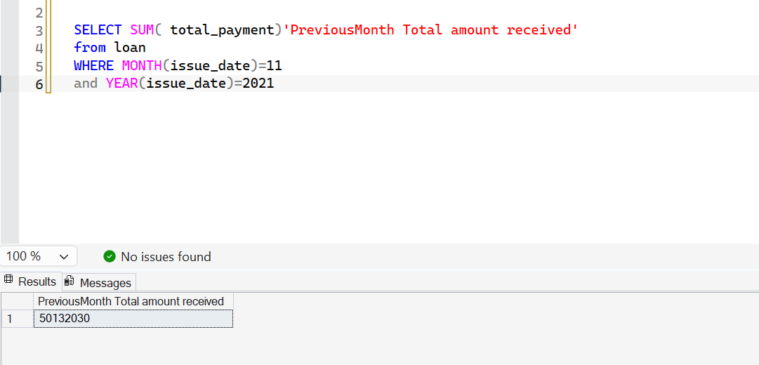
PREV MONTH PAYMENTS

Slide 8
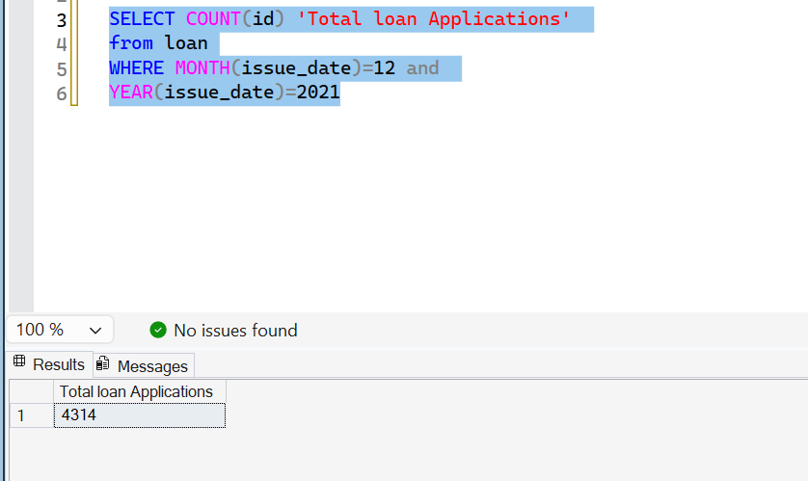
CURRENT LOAN APPLICATIONS

Slide 9
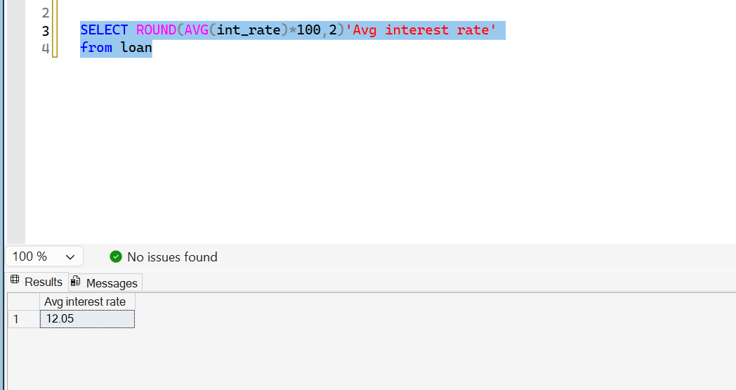
AVERAGE INTEREST RATE

Slide 10
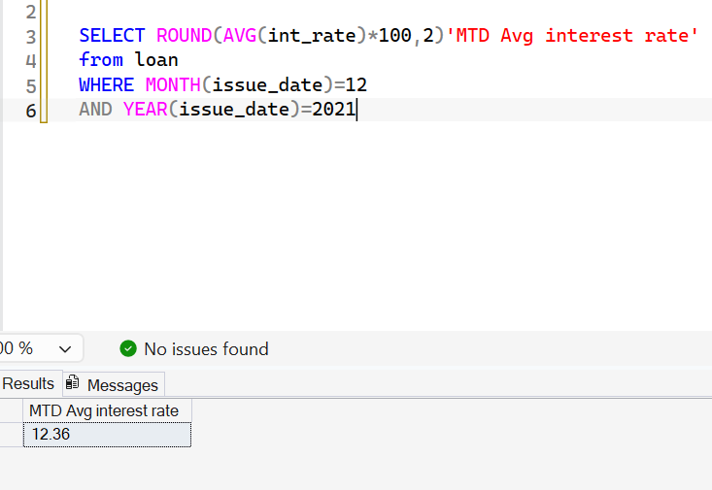
CURRENT AVG INTEREST RATE

Slide 11
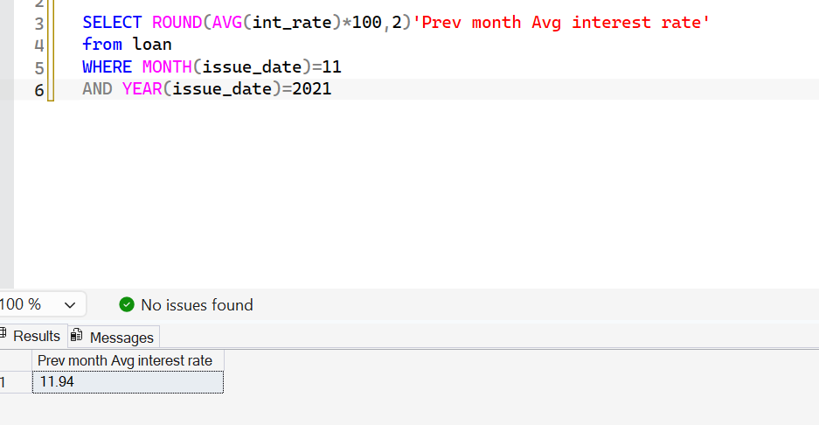
PREV MONTH AVG INTEREST RATE

Slide 12
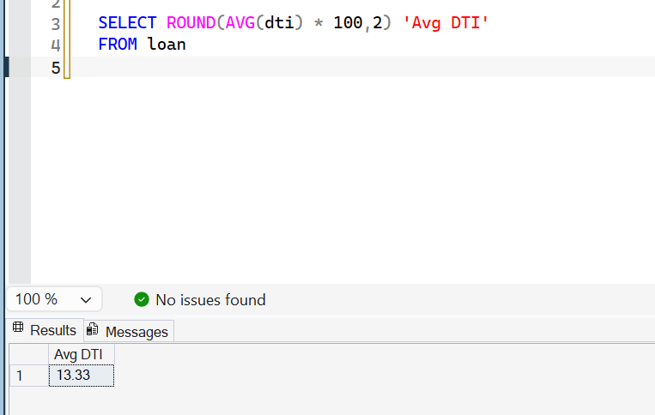
AVERAGE DTI

Slide 13
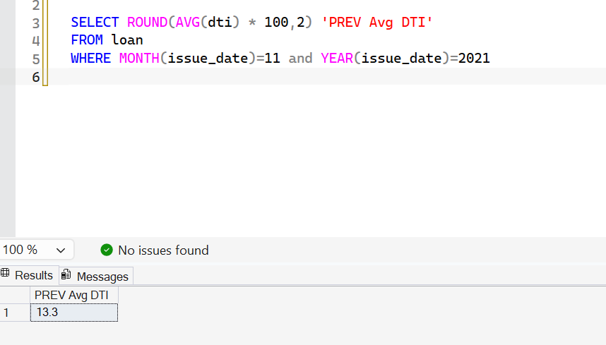
AVERAGE DTI FOR PREV MONTH

Slide 14
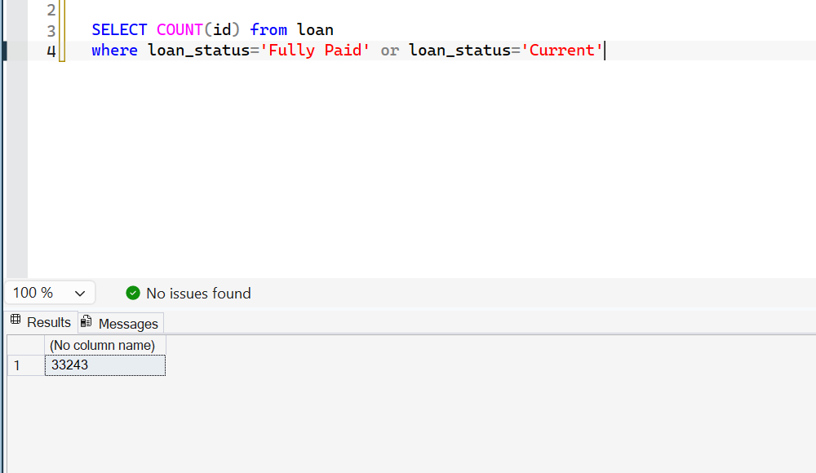
TOTAL GOOD LOANS

Slide 15
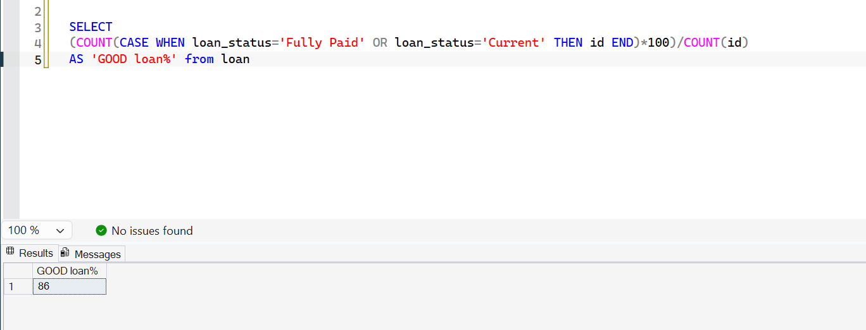
GOOD LOAN PERCENTAGE

Slide 16
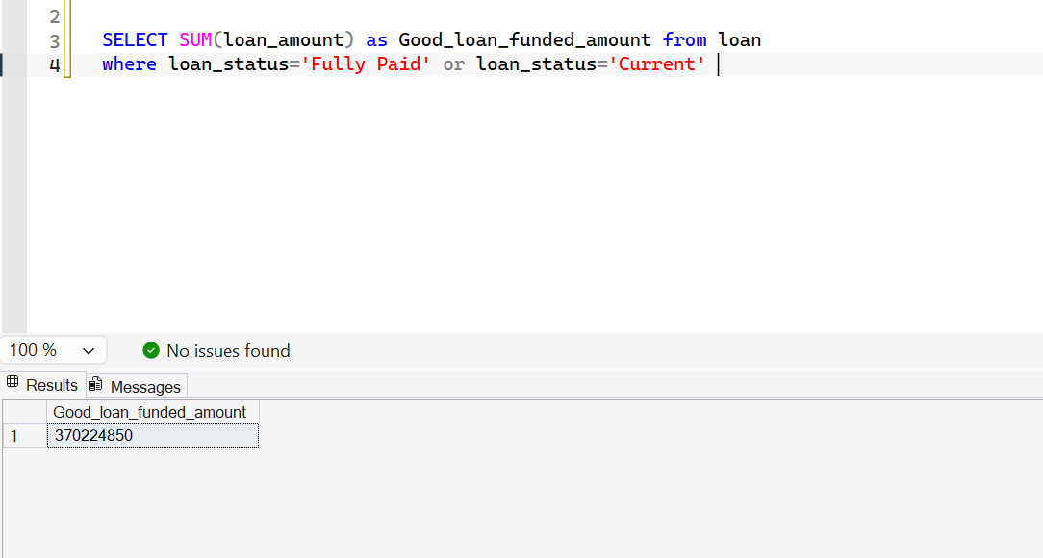
AMOUNT OFFERED TO GOOD LOANS

Slide 17
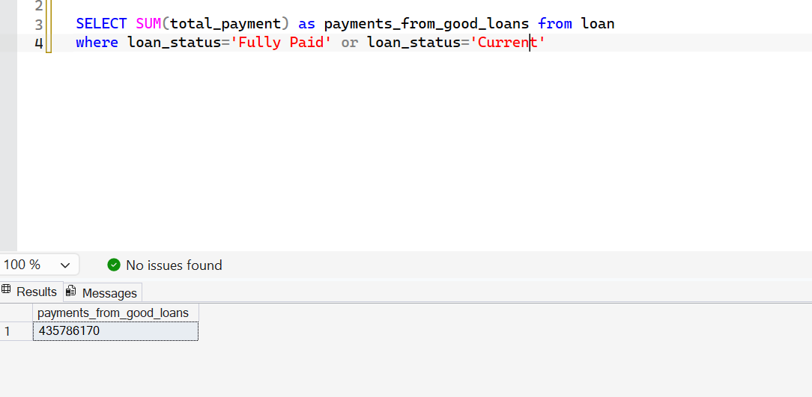
PAYMENTS FROM GOOD LOANS

Slide 18
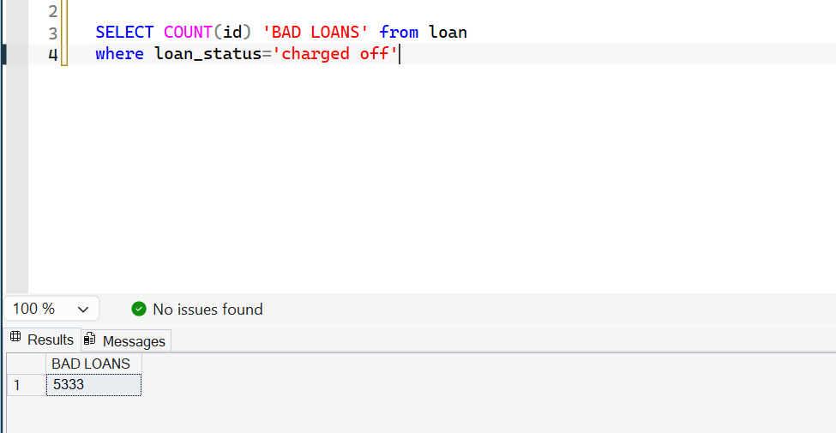
BAD LOANS

Slide 19
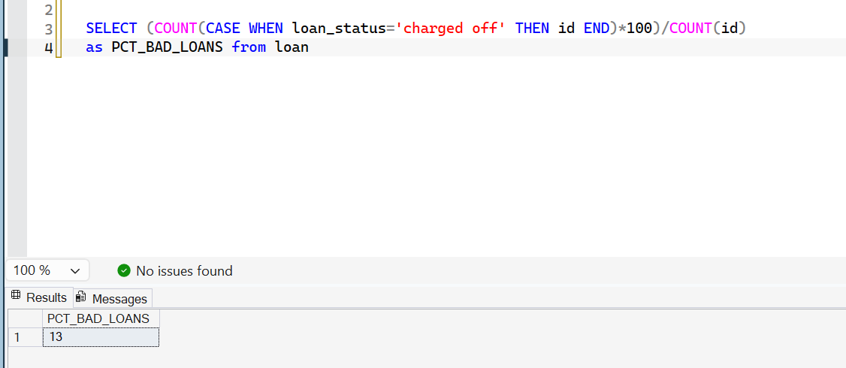
PERCENTAGE OF BAD LOANS

Slide 20
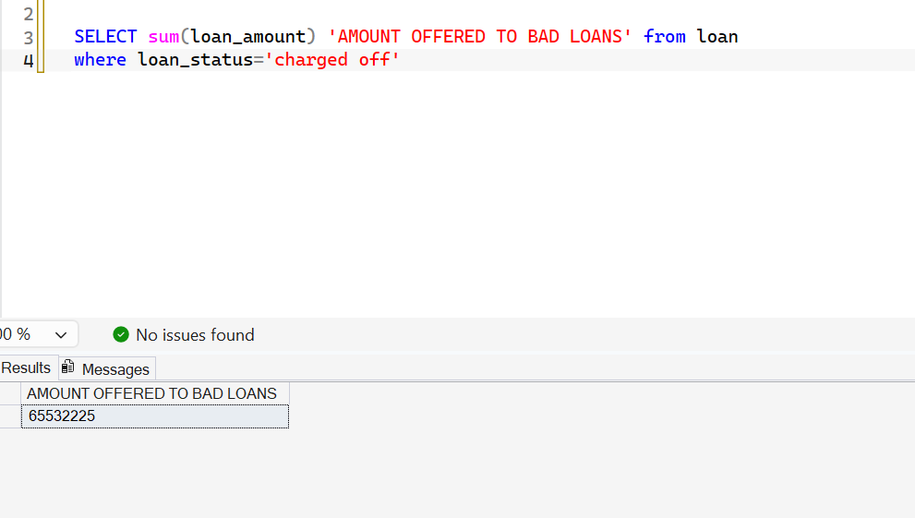
AMOUNT OFFERED TO BAD LOANS

Slide 21
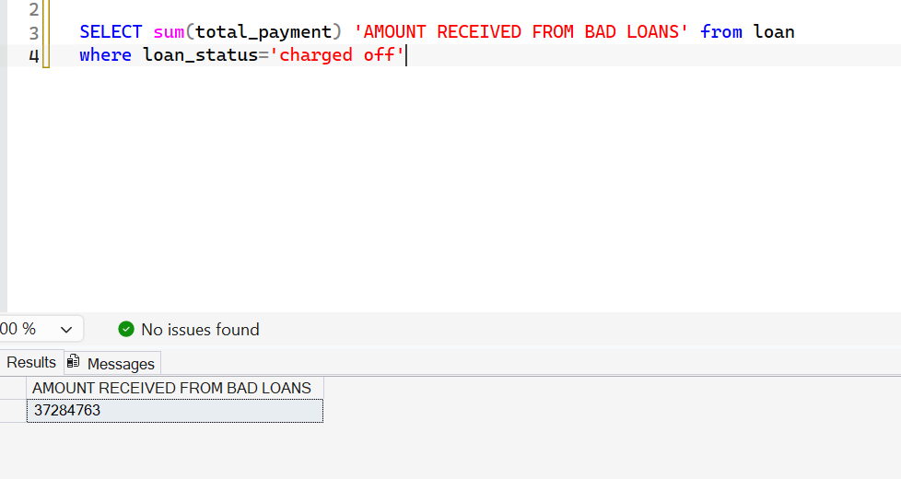
AMOUNT RECEIVED FROM BAD LOANS

Slide 22
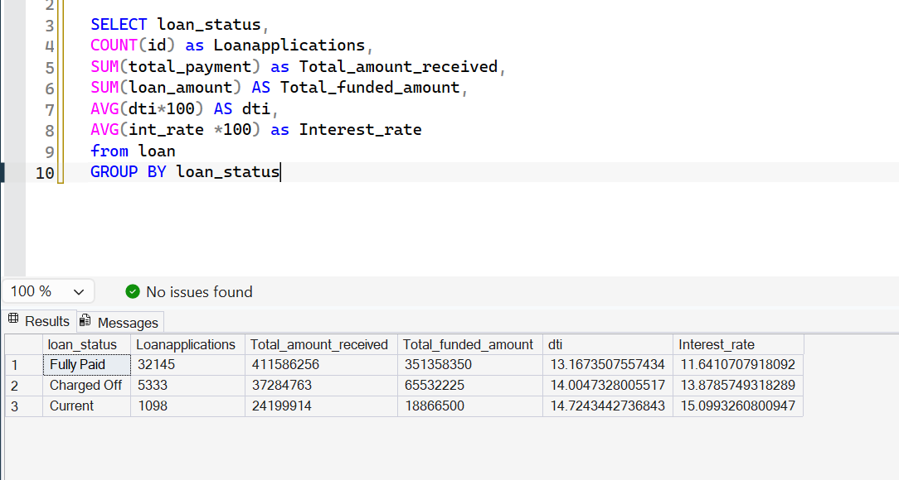
LOAN PERFOMANCE

Slide 23
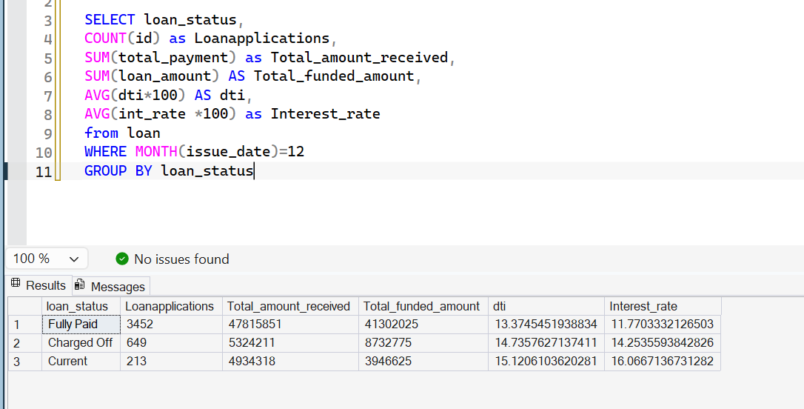
LOAN PERFORMANCE TO DATE

Slide 24
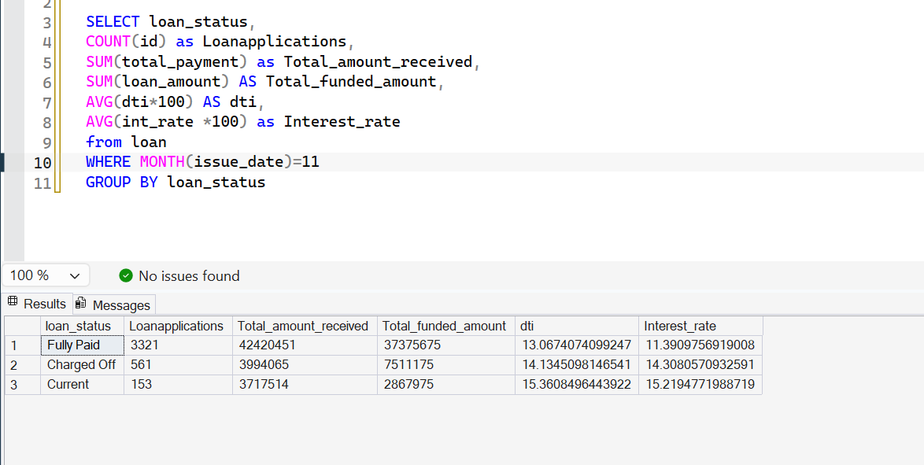
LOAN PERFORMANCE FOR PREV MONTH

Slide 25
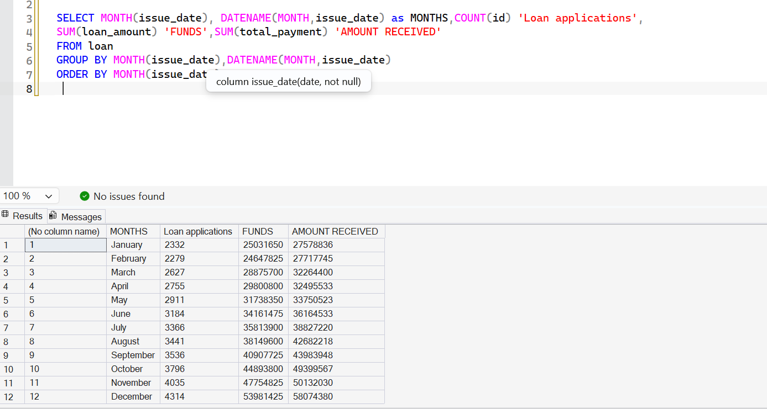
MONTHLY TREND PERFORMANCE

Slide 26
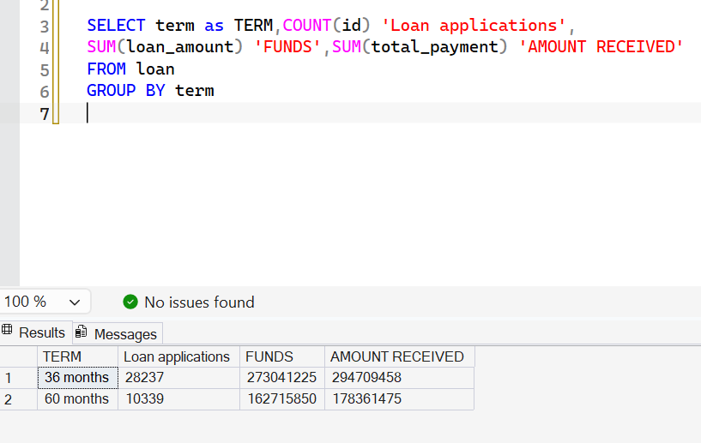
LOAN TREND BY TERMS

Slide 27
PURPOSE TREND

Slide 28
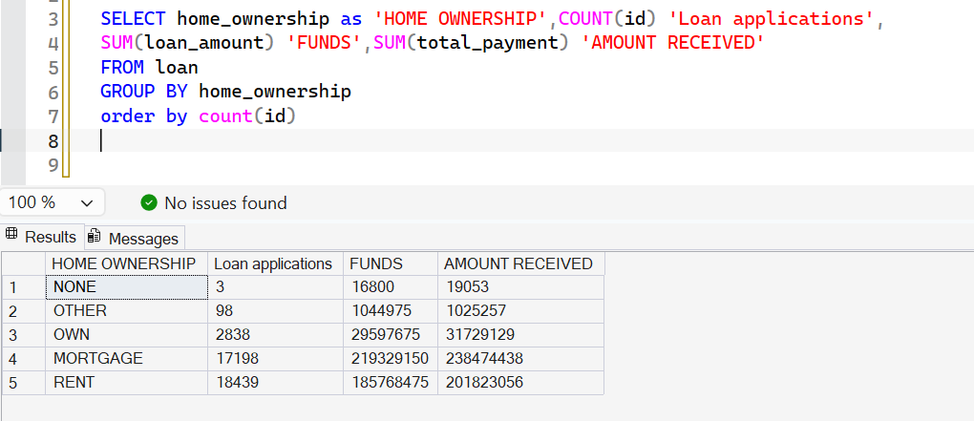
HOMEOWNERSHIP TREND

Slide 29
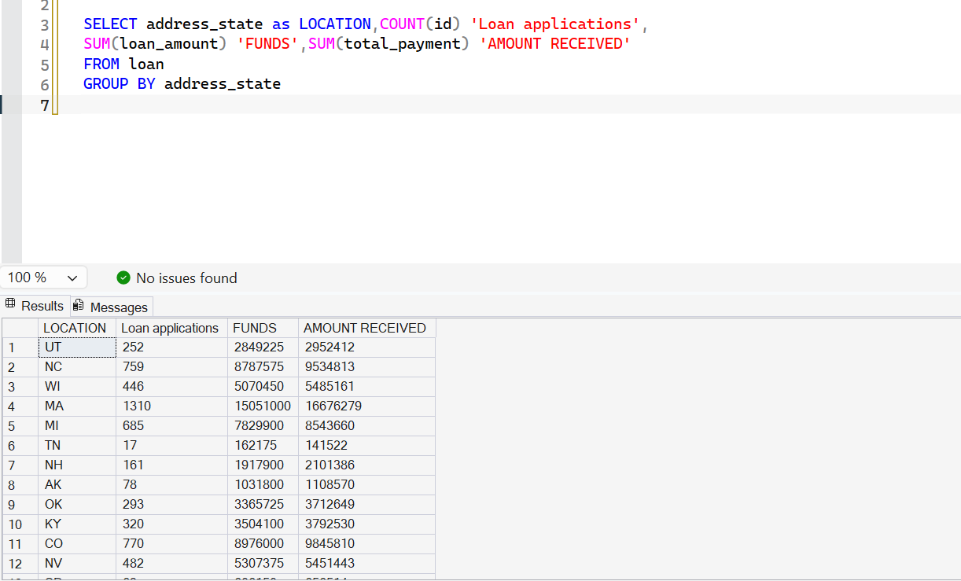
LOCATION TREND

Slide 30
EMPLOYMENT DURATION TREND

